Slide 1
PRESENTATION ON PROJECTION OF POINT/LINE
RAHUL VAISH
IIT Mandi

Slide 2
INTRODUCTION
POINT HAS SIMPLY POSITION BUT NO MAGNITUDE
GENERALLY REPRESENTED BY A VERY SMALL CIRCLE OR A DOT

Slide 3
POSITION OF POINT
IN ORTHOGRAPHIC PROJECTIONS SPACE IS DIVIDED INTO FOUR QUADRANTS
BY TWO REFERENCE PLANES : H.P. AND V.P.
POINT MAY BE SITUATED IN ANY ONE OF THESE QUADRANTS
IT MAY ALSO BE ON ANY ONE OF THE REFERENCE PLANES

Slide 4
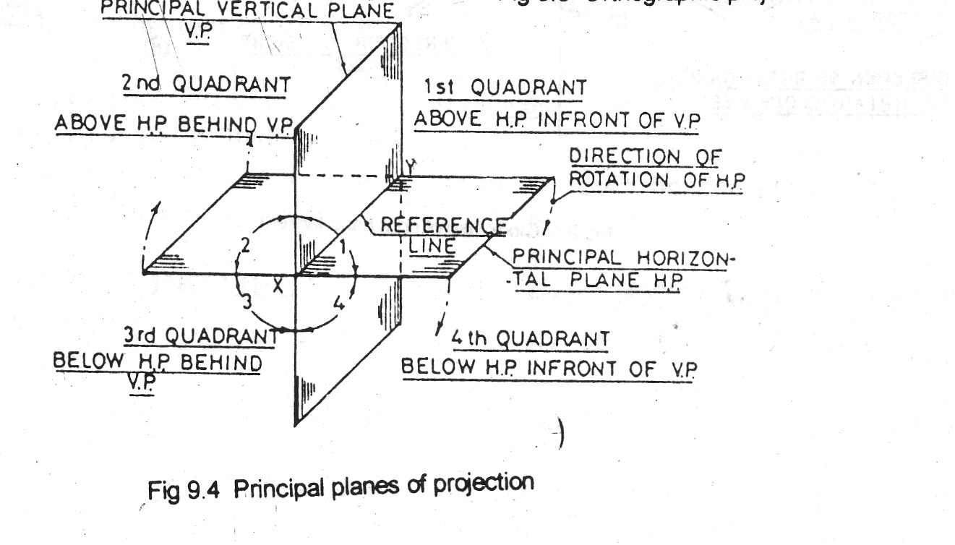
PRINCIPAL PLANES OF PROJECTION

Slide 5
Position of point
Point situated above HP and in front of VP is in 1Q
Point situated above HP and behind VP is in 2Q.
Point situated below HP and behind VP is in 3Q.
Point situated below HP and in front of VP is in 2Q.

Slide 6
POSITION OF POINT
IN FRONT OF VP AND ABOVE HP
IN FRONT OF VP AND IN THE HP
IN THE VP AND ABOVE HP
BEHIND VP AND ABOVE HP
BEHIND VP AND IN HP
BEHIND VP BELOW HP
IN VP BELOW HP
IN FRONT OF VP AND BELOW HP
IN VP AND HP

Slide 7
POSITION OF POINT
AFTER KNOWING DISTANCES OF POINT FROM BOTH THE REFERENCE PLANES, IT IS POSSIBLE TO FIND OUT ITS PROJECTIONS ON HP AND VP
BY EXTENDING PROJECTORS PERPENDICULAR TO BOTH THE PLANES
PROJECTION ON HP IS CALLED TOP VIEW
PROJECTION ON VP IS CALLED FRONT VIEW

Slide 8
Position of point
The original point is represented by capital letters e.g A, B, P & Q
The top view or top plan or plan is represented by lower case letters for example a b p & q.
The front view or front elevation or elevation is represented by a lower case letter with dash for example a’ b’ p’ & q’

Slide 9
Position of point
THE LINE OF INTERSECTION OF HP & VP IS KNOWN AS THE HINGE LINE OR GROUND LINE OR REFERENCE LINE. IT IS GENERALLY NAMED THE XY LINE
FOR DRAWING THE PROJECTIONS ON A 2D PIECE OF PAPER THE HP IS IMAGINED TO HAVE BEEN ROTATED THE HINGE LINE XY IN SUCH A WAY THAT THE 1Q OPENS OUT AND THE HP IS BROUGHT IN TO THE PLANE OF THE VP.

Slide 10
TWO QUADRANT SYSTEM FOR TWO DIRECTION OF SIGHT
ANTI CLOCKWISE OR LEFT HAND SYSTEM
CLOCKWISE OR RIGHT HAND SYSTEM

Slide 11
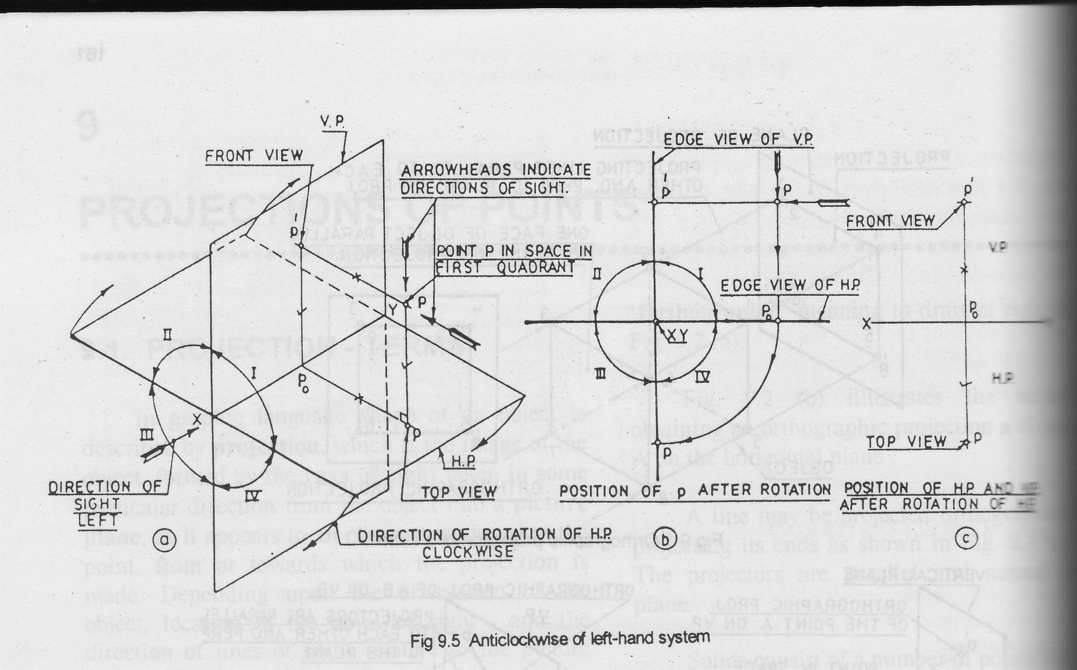
ANTICLOCKWISE LEFT HAND SYSTEM

Slide 12
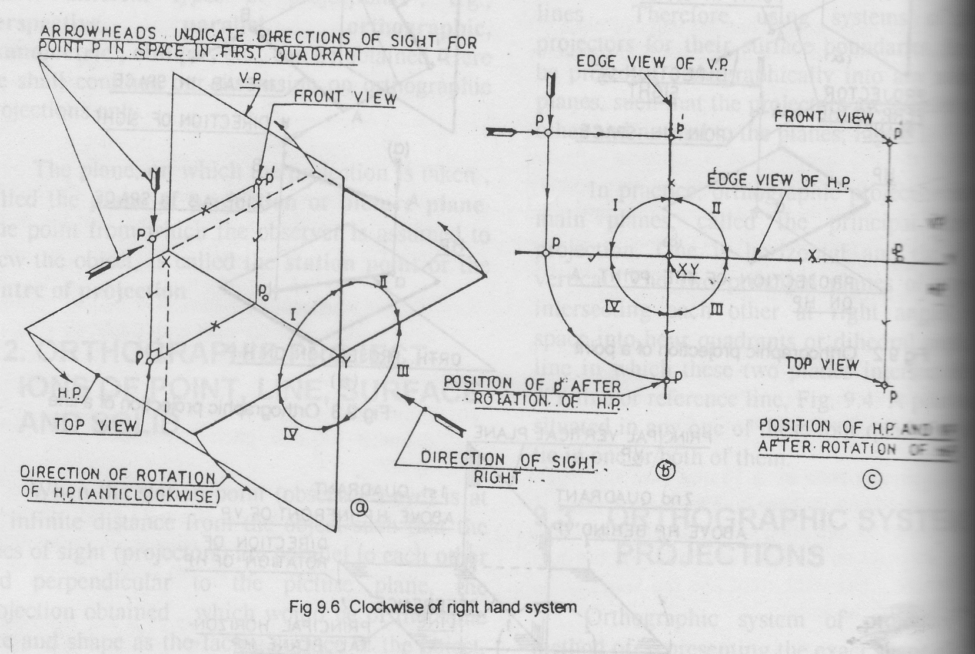
CLOCKWISE RIGHT HAND SYSTEM

Slide 13
PROJECTION OF A POINT IN 1Q
THE POINT P IN 1Q IS HAVING P’ AS FRONT VIEW AND P AS THE TOP VIEW.
HOLD VP AND REVOLVE HP IN CLOCKWISE DIRECTION THROUGH 90 DEG.
THE PROJECTIONS P’ AND P LIE ON A PROJECTOR PERPENDICULAR TO THE XY LINE AND THE FRONT VIEW P’ AFTER RABATMENT ,LIES ABOVE THE XY LINE AND THE PLAN P BELOW IT.

Slide 14
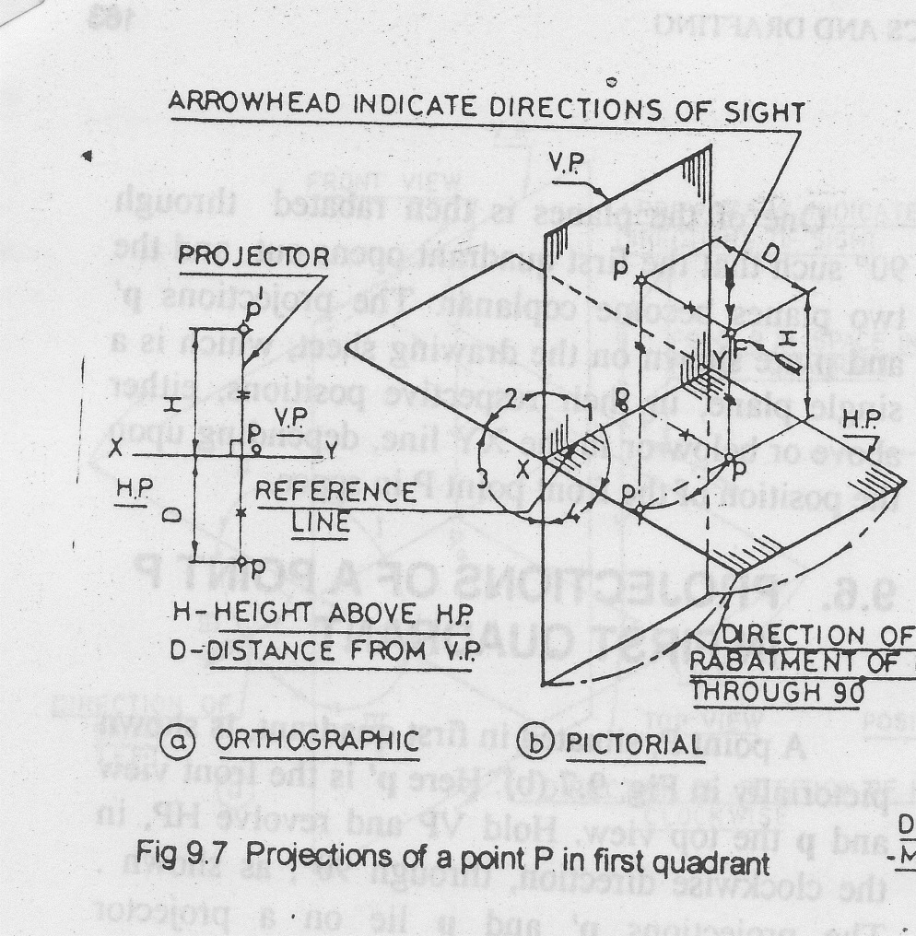
PROJECTION OF POINT ‘P’ IN 1ST QUADRANT

Slide 15
PROJECTION OF POINT ‘P’ IN 2nd QUADRANT
HOLD VP AND REVOLVE HP THROUGH 90 DEG IN CLOCKWISE DIRECTION.
AFTER RABATMENT THE ELEVATION P’ AND PLAN P BOTH LIE ABOVE XY LINE, ON A PROJECTOR PERPENDICULAR TO XY.

Slide 16
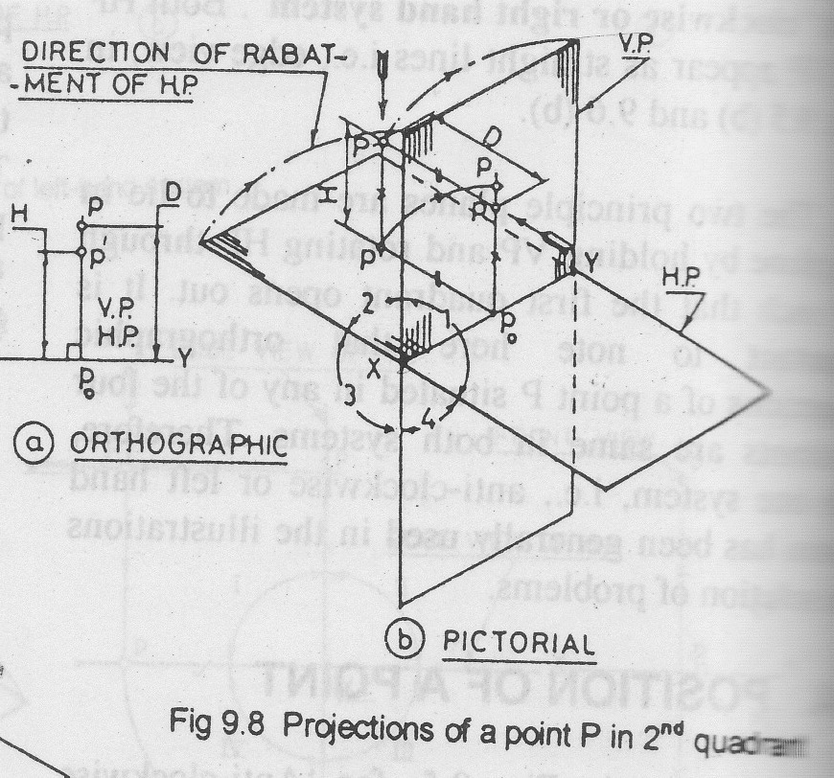
PROJECTION OF POINT ‘P’ IN 2ND QUADRANT

Slide 17
PROJECTION OF POINT ‘P’ IN 3rd QUADRANT
HOLD VP AND REVOLVE HP THROUGH 90 DEG IN CLOCKWISE DIRECTION SO THAT 1Q OPENS OUT.
AFTER RABATMENT THE ELEVATION P’ LIES BELOW AND PLAN P LIES ABOVE THE XY LINE ON A COMMON PROJECTOR PERPENDICULAR TO XY.
THE DISTANCE OF P’ BELOW XY IS EQUAL TO THE DISTANCE OF P BELOW HP AND THE DISTANCE OF TOP VIEW ABOVE THE XY IS EQUAL TO THE DISTANCE OF THE POINT P BEHIND VP

Slide 18
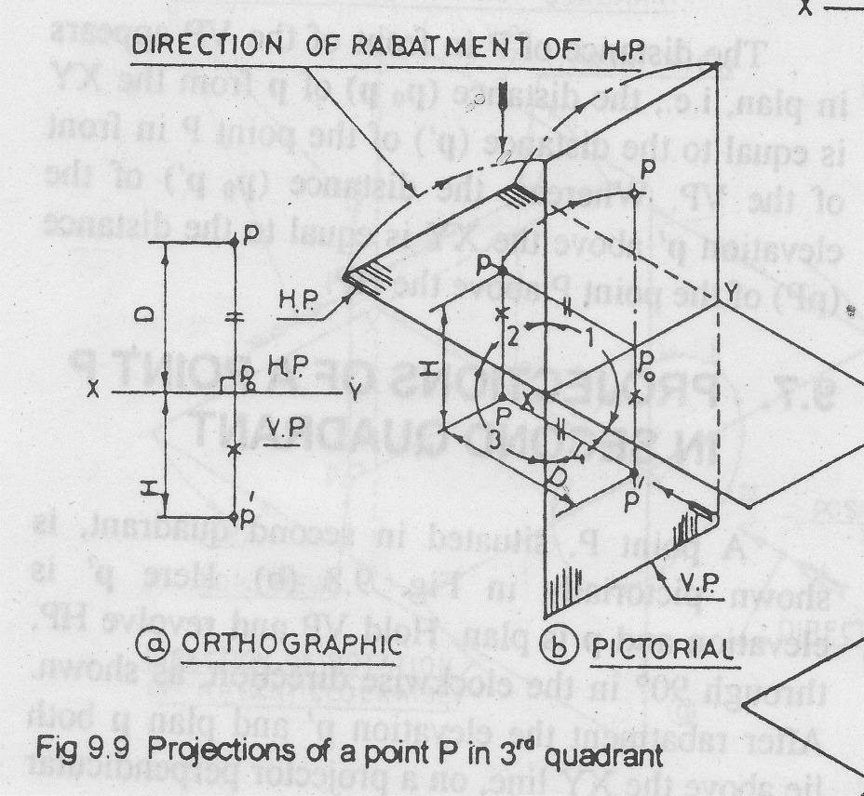
PROJECTION OF POINT IN 3RD QUADRANT

Slide 19
PROJECTION OF POINT IN 4th QUADRANT
HOLD VP AND REVOLVE HP THROUGH 90 DEG IN CLOCKWISE DIRECTION.
AFTER RABATMENT THE ELEVATION P’ AND PLAN P LIES BELOW THE XY LINE ON A COMMON PROJECTOR PERPENDICULAR TO XY.
THE DISTANCE OF P’ BELOW XY IS EQUAL TO THE DISTANCE OF THE POINT P BELOW HP AND THE DISTANCE OF TOP VIEW P BELOW THE XY IS EQUAL TO THE DISTANCE OF THE POINT P IN-FRONT OF VP

Slide 20
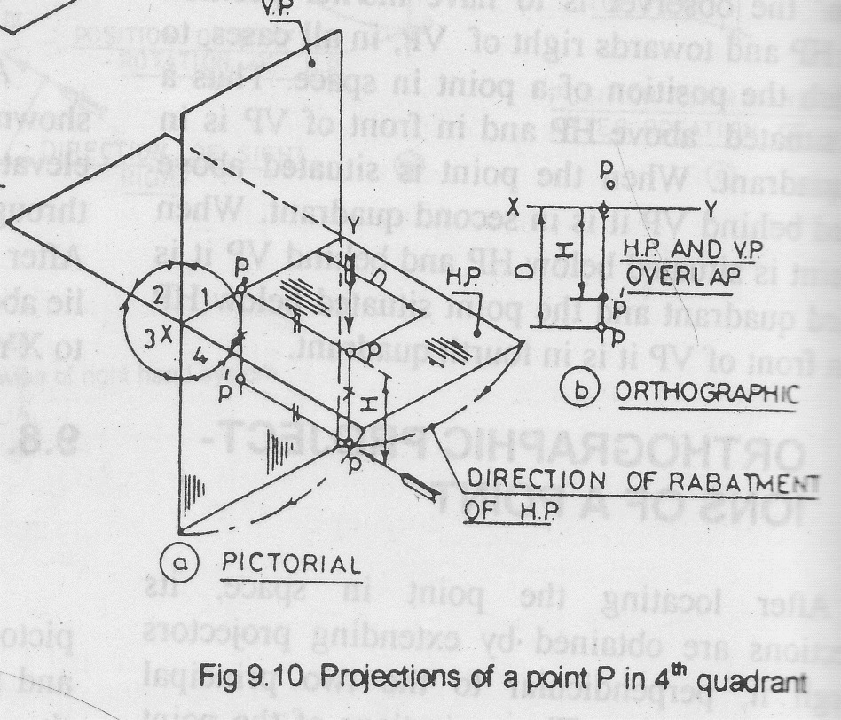
PROJECTION OF POINT IN 4TH QUADRANT

Slide 21
Points to Remember
THE FRONT VIEW AND TOP VIEW OF A POINT ARE ALWAYS ON THE SAME VERTICAL LINE.
IF THE POINT IS ABOVE HP ,ITS FRONT VIEW IS ABOVE XY LINE ,IF THE GIVEN POINT IS BELOW THE HP ,ITS FRONT VIEW IS BELOW THE XY LINE.
IF THE POINT IS IN FRONT OF VP ,ITS TOP VIEW IS BELOW THE XY LINE. IF THE GIVEN POINT IS BEHIND VP, ITS TOP VIEW IS ABOVE THE XY LINE

Slide 22
Important observations
IN FIRST AND THIRD QUADRANT THE PROJECTION OF THE POINT P LIE ON THE OPPOSITE SIDES OF THE XY LINE.
WHERE AS, BOTH THE PROJECTIONS LIE ON THE SAME SIDE OF IT WHEN THE POINT P LIES IN 2ND Q OR 4TH Q
THE PROJECTIONS OF GEOMETRICAL SHAPES IN 2Q OR 4Q MAY OVERLAP EACH OTHER AND WILL NOT AFFORD A CLEAR VISUALIZATION AND INTERPRETATION OF THE OBJECT DRAWN.
THEREFORE PROJECTIONS OF AN OBJECT EITHER IN 1Q OR IN 3Q IS USED

Slide 23
PROBLEMS
DRAW PROJECTIONS OF FOLLOWING POINTS IN DIFFERENT QUADRANTS:
POINT A,25 IN FRONT OF VP AND 30 MM ABOVE HP
POINT B , 22MM BEHIND VP AND 28 MM ABOVE HP
POINT C, 28MM BEHIND VP AND 30MM BELOW HP
POINT D, 40MM IN FRONT OF VP AND 25MM BELOW HP

Slide 24
PROBLEMS
POINT E, 32MM IN FRONT OF VP AND IN HP
POINT F, 35MM BEHIND VP AND IN HP
POINT G, IN VP AND 40MM BELOW HP
POINT H, IN VP AND HP

Slide 25
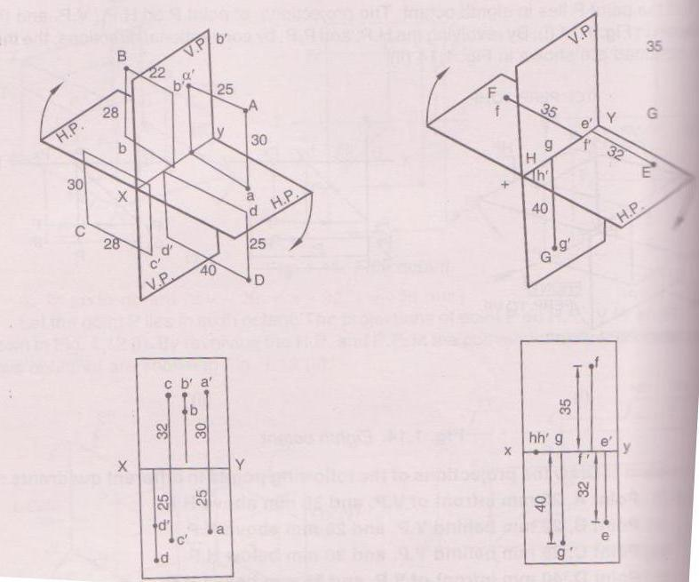
PROBLEMS

Slide 26
PROBLEMS
APOINT P IS 25MM IN FRONT OF VP AND 40MM ABOVE HP. ANOTHER POINT Q IS 40MM IN FRONT OF VP AND 25MM ABOVE HP. THE DISTANCE MEASURED BETWEEN PROJECTORS IS 40MM. DRAW THE PROJECTIONS AND FIND THE DISTANCE BETWEEN P AND Q.
SOLUTION:BOTH THE POINTS LIE IN THE FIRST QUADRANT

Slide 27
PROBLEMS
TAKE A DISTANCE OF 40MM BETWEEN THE PROJECTORS OF TWO POINTS P AND Q ON xy LINE
DRAW PROJECTIONS OF POINT P ON LEFT END OF PROJECTOR WHICH IS 25MM BELOW xy LINE AND 40MM ABOVE xy LINE
SIMILARLY DRAW PROJECTIONS OF POINT Q ON RIGHT END OF PROJECTOR WHICH IS 40MM BELOW xy LINE AND 25MM ABOVE xy LINE

Slide 28
PROBLEMS
JOIN p’q’ AND pq WHICH ARE FRONT VIEW AND TOP VIEW OF LINE PQ RESPECTIVELY
AT p AND q DRAW PERPENDICULARS Pp AND Qq EQUAL TO 40MM AND 25MM RESPECTIVELY
JOIN P AND Q
THEN PQ IS REQUIRED DISTANCE BETWEEN P AND Q

Slide 29
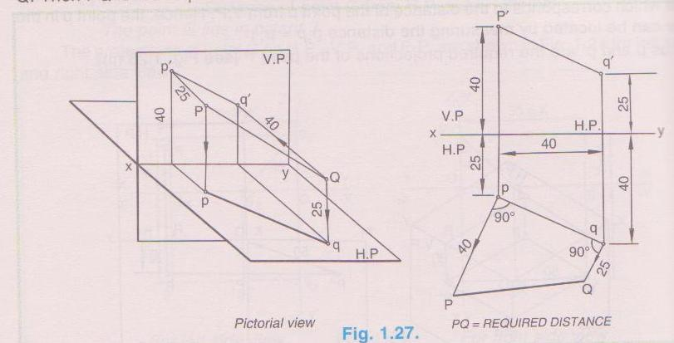
PROBLEMS

Slide 30
INTRODUCTION
A STRAIGHT LINE IS THE SHORTEST DISTANCE BETWEEN TWO POINTS.
PROJECTIONS OF THE ENDS OF ANY LINE CAN BE DRAWN USING THE PRINCIPLES FOR THE PROJECTIONS OF POINTS.

Slide 31
INTRODUCTION
TOP VIEWS OF THE TWO END POINTS OF A LINE, WHEN JOINED GIVE THE TOP VIEW OF THE LINE.
FRONT VIEWS OF THE TWO END POINTS OF THE LINE ,WHEN JOINED ,GIVE THE FRONT VIEW OF THE LINE. BOTH THESE PROJECTIONS ARE STRAIGHT LINES.

Slide 32
POSITION OF STRAIGHT LINE IN SPACE
THE LINE IN SPACE MAY BE PARALLEL, PERPENDICULAR OR INCLINED TO EITHER THE HP OR THE VP OR BOTH OF THEM
IT MAY BE IN ONE OR BOTH THE REFERENCE PLANES
THE LINE ENDS MAY BE IN ONE OR TWO QUADRANTS.

Slide 33
POSITIONS OF STRAIGHT LINES
CASE I: STRAIGHT LINE PARALLEL TO BOTH PLANES
RULE NO. I A STRAIGHT LINE REPRESENTS ITS TRUE LENGTH IN THAT PLANE TO WHICH IT IS PARALLEL
IN FIG. LINE AB PARALLEL TO HP AND VP
DISTANCES OF END POINTS FROM HP AND VP ARE EQUAL
TOP VIEW ab AND FRONT VIEW a’b’ ARE EQUAL TO LINE AB AND PARALLEL TO xy LINE

Slide 34
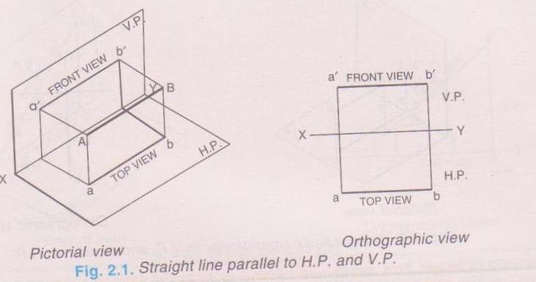
STRAIGHT LINE PARALLEL TO BOTH PLANES

Slide 35
POSITIONS OF STRAIGHT LINES
CASE II:PERPENDICULAR TO ONE PLANE AND PARALLEL TO OTHER
RULE II: LINE REPRESENTS POINT IN THAT PLANE TO WHICH IT IS PERPENDICULAR
WHEN A LINE PERPENDICULAR TO ONE PLANE IT WILL BE PARALLEL TO OTHER REFERENCE PLANE,AS HP AND VP ARE PERPENDICULAR TO EACH OTHER

Slide 36
POSITIONS OF STRAIGHT LINES
LINE PERPENDICULAR TO HP AND PARALLEL TO VP
IN FIG. LINE AB IS PERPENDICULAR TO HP, AND PARALLEL TO VP
ITS FRONT VIEW a’b’ WILL BE EQUAL TO TRUE LENGTH OF LINE AB
TOP VIEW ab WILL BE A POINT AS SHOWN IN HP

Slide 37
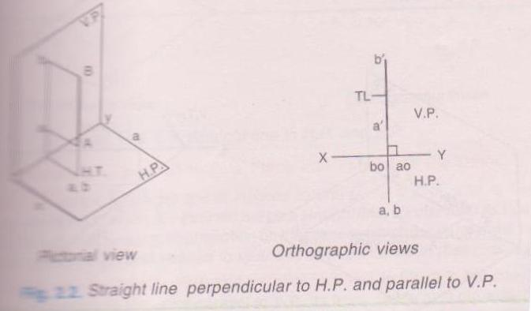
LINE PERPENDICULAR TO HP AND PARALLEL TO VP

Slide 38
POSITIONS OF STRAIGHT LINES
LINE PERPENDICULAR TO VP AND PARALLEL TO HP
IN FIG. LINE AB PERPENDICULAR TO VP AND PARALLEL TO HP
TOP VIEW ab EQUAL TO LENGTH OF LINE
FRONT VIEW a’b’ WILL BE APOINT IN VP

Slide 39
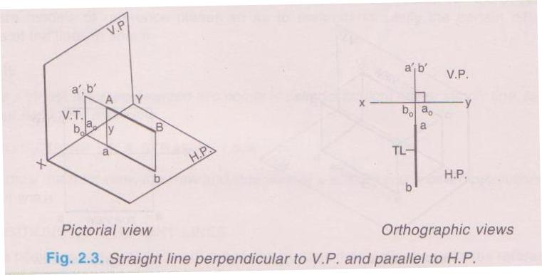
LINE PERPENDICULAR TO VP AND PARALLEL TO HP

Slide 40
POSITIONS OF STRAIGHT LINES
CASE III: LINE CONTAINED BY ONE OR BOTH THE PLANES
RULE III:LINE REPRESENTS ITS TRUE LENGTH IN THAT PLANE TO WHICH THE LINE IS CONTAINED
PROJECTORS OF TRUE LENGTH ALWAYS COME ON xy LINE

Slide 41
POSITIONS OF STRAIGHT LINES
LINE CONTAINED BY HP
IN FIG. TOP VIEW ab IS EQUAL TO TRUE LENGTH OF LINE AB
FRONT VIEW a’b’ IS SHORTER THAN LINE AB AND LIE ON xy LINE

Slide 42
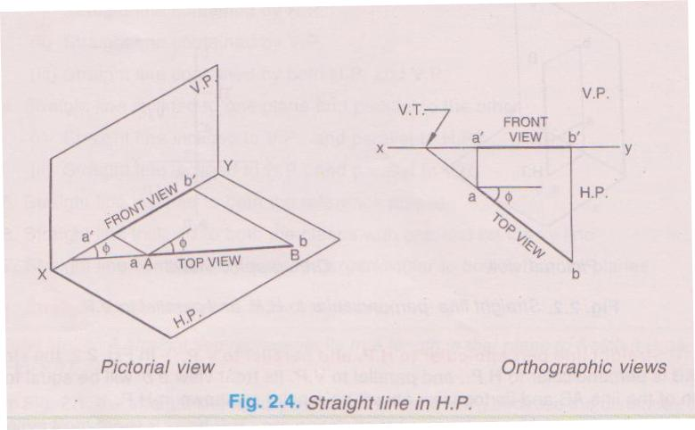
LINE CONTAINED BY HP

Slide 43
POSITIONS OF STRAIGHT LINES
LINE CONTAINED BY VP
FRONT VIEW a’b’ IS EQUAL TO TRUE LENGTH OF LINE AB
TOP VIEW ab IS SHORTER THAN LINE AB AND LIE ON xy LINE

Slide 44
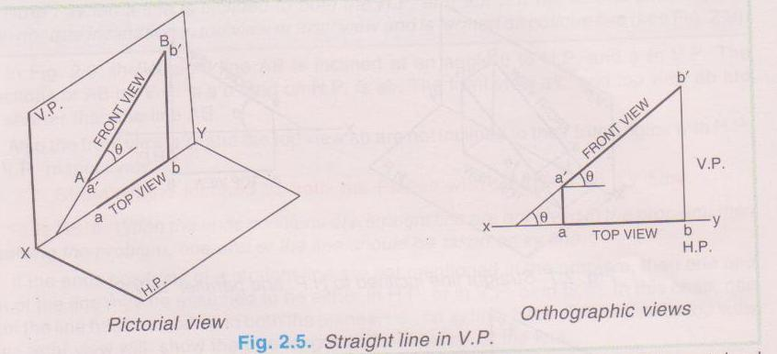
LINE CONTAINED BY VP

Slide 45
POSITIONS OF STRAIGHT LINES
LINE CONTAINED BY BOTH HP AND VP
ITS TOP VIEW ab AND FRONT VIEW a’b’ COINCIDES WITH xy LINE

Slide 46
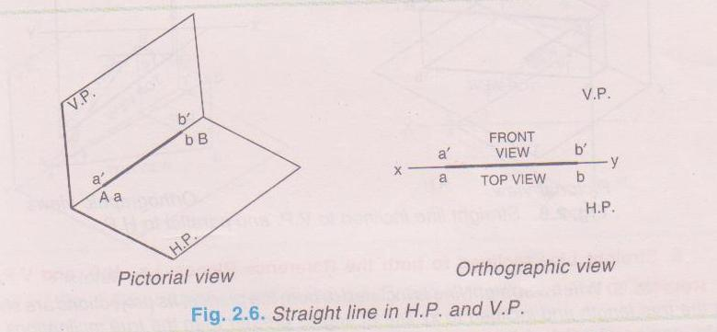
LINE CONTAINED BY BOTH HP AND VP

Slide 47
POSITIONS OF STRAIGHT LINES
LINE INCLINED TO ONE PLANE AND PARALLEL TO OTHER
RULE IV:ITS PROJECTION ON THE PLANE TO WHICH IT IS INCLINED WILL BE A STRAIGHT LINE, SHORTER THAN ITS TRUE LENGTH BUT PARALLEL TO xyLINE
SIMULTANEOUSLY ITS PROJECTION ON THE PLANE TO WHICH IT IS PARALLEL WILL BE A STRAIGHT LINE EQUAL TO ITS TRUE LENGTHJ AND INCLINED TO xy LINE AT ITS TRUE INCLINATION

Slide 48
POSITIONS OF STRAIGHT LINES
LINE INCLINED TO HP AND PRALLEL TO VP
LINE AB IS INCLINED AT AN ANGLE ΘTO HP AND PARALLEL TO VP
ITS FRONT VIEW a’b’ IS EQUAL TO LINE AB AND ITS INCLINATION IS IN ITS TRUE FORM
TOP VIEW ab IS SHORTER THAN LINE AB

Slide 49
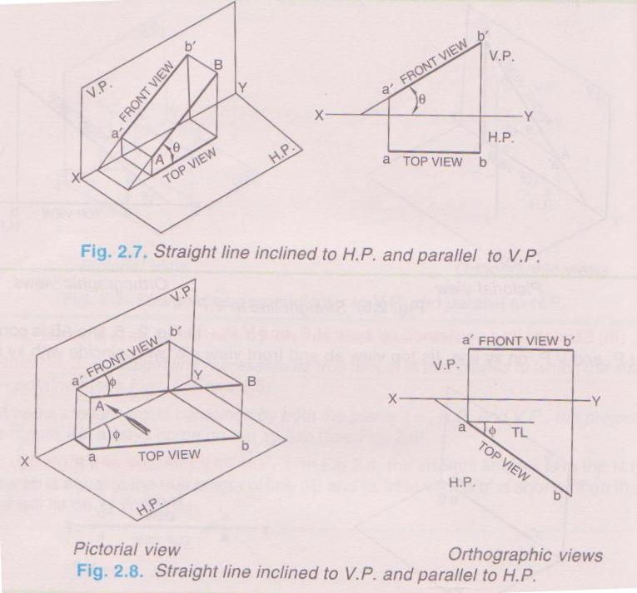
LINE INCLINED TO ONE PLANE AND PARALLEL TO OTHER

Slide 50
POSITIONS OF STRAIGHT LINES
LINE INCLINED TO VP AND PRALLEL TO HP
LINE AB IS INCLINED AT AN ANGLE φTO VP AND PARALLEL TO HP
ITS TOP VIEW ab IS EQUAL TO LINE AB AND ITS INCLINATION IS IN ITS TRUE FORM
FRONT VIEW a’b’ IS SHORTER THAN LINE AB

Slide 51
POSITIONS OF STRAIGHT LINES
LINE INCLINED TO BOTH THE PLANES
RULE V: ITS PROJECTIONS ARE SHORTER THAN TRUE LENGTH AND INCLINED TO xy LINE AT ANGLES GREATER THAN TRUE INCLINATIONS
THE GREATER ANGLES WITH xy LINE ARE CALLED APPARENT ANGLES
LINE INCLINED TO BOTH THE PLANES NEITHER SHOW ITS TRUE LENGTH NOR TRUE INCLINATIONS IN TOP VIEW AND FRONT VIEW AND TERMED AS OBLIQUE LINE

Slide 52
POSITIONS OF STRAIGHT LINES
IN FIG. LINE AB IS INCLINED AT AN ANGLE θ TO HP AND φ TO VP
PROJECTIONS OF AB ON VP IS a’b’ AND ON HP IS ab
FRONT VIEW a’b’ AND TOP VIEW ab ARE BOTH SHORTER THAN LINE AB
ALSO BOTH VIEWS ARE NOT INCLINED TO THEIR TRUE ANGLES WITH HP AND VP RESPECTIVELY

Slide 53
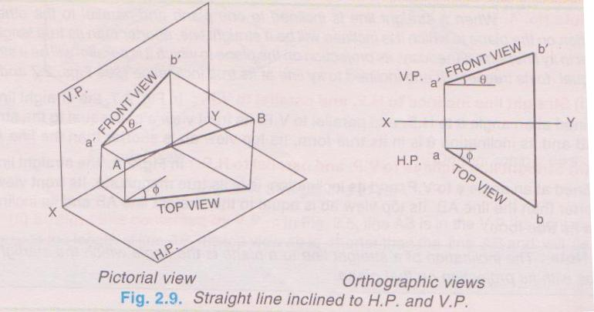
LINE INCLINED TO BOTH THE PLANES

Slide 54
POSITIONS OF STRAIGHT LINES
LINE INCLINED TO BOTH THE PLANES WITH ONE END ON XY LINE
RULE VI: WHEN END POSITIONS OF LINE ARE NOT GIVEN IN THE PROBLEM, THEN ONE END OF LINE SHOULD BE TAKEN ON xy LINE i.e. EITHER IN HP OR VP OR BOTH
NEITHER ITS TOP VIEW OR ITS FRONT VIEW WILL SHOW THE TRUE LENGTH AND INCLINATION OF LINE

Slide 55
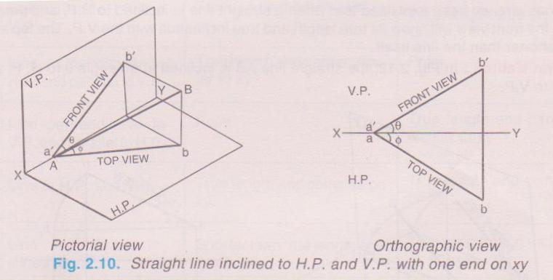
LINE INCLINED TO BOTH THE PLANES WITH ONE END ON XY LINE

Slide 56
POSITIONS OF STRAIGHT LINES
LINE CONTAINED BY PLANE PERPENDICULAR TO BOTH THE PLANES
RULE VII: WHEN SUM OF INCLINATION OF A LINE WITH HP AND VP IS EQUAL TO 90 DEGREES, THEN PROJECTIONS i.e. TOP VIEW AND FRONT VIEW ARE IN ONE STRAIGHT LINE PERPENDICULAR TO xy LINE
WHEN θ+φ IS EQUAL TO 90 DEGREES THE LINE WILL CONTAINED BY PLANE PERPENDICULAR TO BOTH HP AND VP

Slide 57
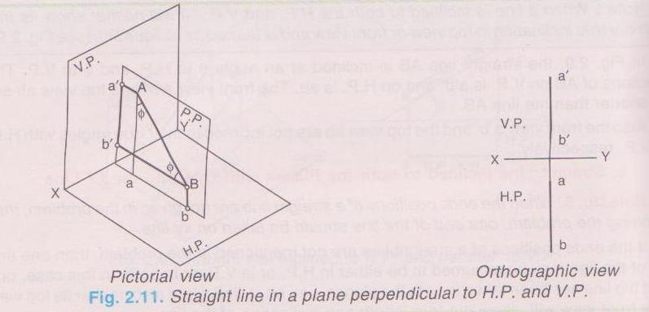
LINE CONTAINED BY PLANE PERPENDICULAR TO BOTH THE PLANES

Slide 58
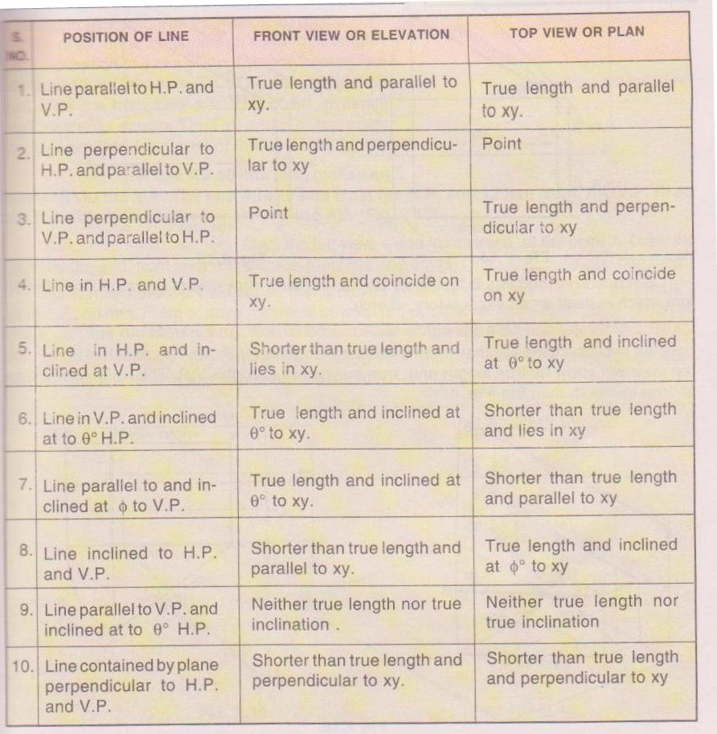
TABLE SHOWING POSITIONS OF LINE

Slide 59
PROBLEM
A STRAIGHT LINE AB 50MM LONG MAKES AN ANGLE OF 30 DEG. TO HP. END A IS 12MM ABOVE HP AND 15 MM IN FRONT OF VP. DRAW TOP VIEW AND FRONT VIEW OF LINE AB
SOLUTION:MARK TOP VIEW a AND FRONT VIEW a’ OF END POINT A OF LINE AB
ASSUMING LINE AB TO BE PARALLEL TO BOTH HP AND VP IN ITS INITIAL POSITIONS

Slide 60
PROBLEM
THROUGH a AND a’ DRAW TOP VIEW ab1 AND FRONT VIEW a’b1’ EQUAL TO LENGTH AB 50MM
ROTATE FRONT VIEW a’b1’TO AN ANGLE OF 30 DEG. TO xy LINE i.e. TO HP AND MARK IT AS a’b’
FROM b’ DRAW VERTICAL PROJECTOR TO MEET ab1 AT b
THEN ab AND a’b’ ARE THE REQUIRED TOP VIEW AND FRONT VIEW OF LINE AB

Slide 61
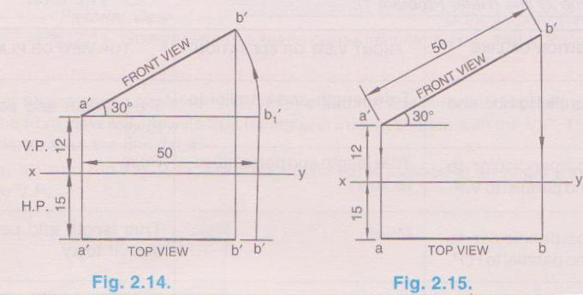
PROBLEM

Slide 62
PROBLEM
A LINE AB 50MM LONG MAKES AN ANGLE OF 45 DEG. TO VP. THE END A IS 15MM FROM HP AND 12MM FROM VP. DRAW TOP VIEW AND FRONT VIEW OF LINE AB.
SOLUTION:MARK TOP VIEW a AND FRONT VIEW a’ OF POINT A
ASSUMING LINE AB TO BE PARALLEL TO HP AND VP DRAW TOP VIEW ab1 AND FRONT VIEW a’b1’ PARALLEL TO xy LINE OF LENGTH 60MM

Slide 63
PROBLEM
NOW ROTATETOP VIEW ab1 TO MAKE AN ANGLE OF 45 DEG. TO xy LINE AND MARK IT AS ab
FROM b DRAW VERTICAL UPWARD PROJECTOR TO MEET ab1’ AT b’
THEN ab AND a’b’ ARE THE REQUIRED TOP VIEW AND FRONT VIEW OF LINE AB

Slide 64
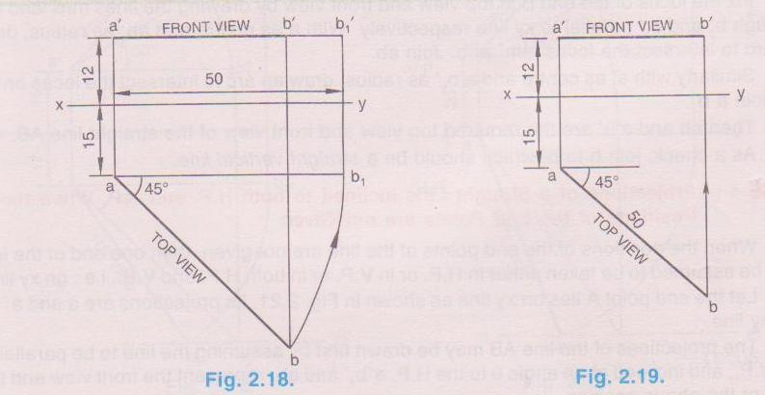
PROBLEM

Slide 65
REFERENCES
A TEXT BOOK OF ENGINEERING DRAWING BY Er R.K.DHAWAN

Slide 66
THANK YOU

